Slide 1


Project week
UofT Data Bootcamp

Slide 2
Pursuit of Happiness https://github.com/SShojaie/Suicide_squad.git
Eben Haezer
J Kurt Baltero
Momotaz Mahin Khan
Sheri Shojaie
Vivi Santosa

Slide 3


Does money buy you happiness?

Slide 4
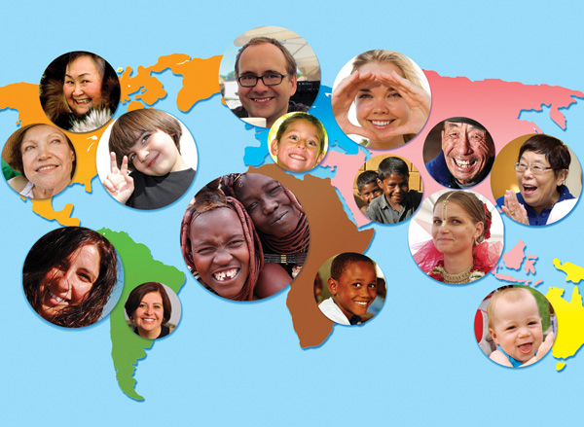

Developed by the United Nations Sustainable Development Solutions Network
Annual publication with rankings of national happiness based on:
Respondents ratings of their own lives
Life factors (eg. GDP and Social Support)
Why this data exists:
Create a holistic & universal definition and measure of happiness
Measure of happiness among people to guide public policy
Number of years
Data dating back to 2005
First official report published in 2012
Key dataset: 2005 – 2019
Scope of our analysis: 2017 (complete set of data)

Slide 5
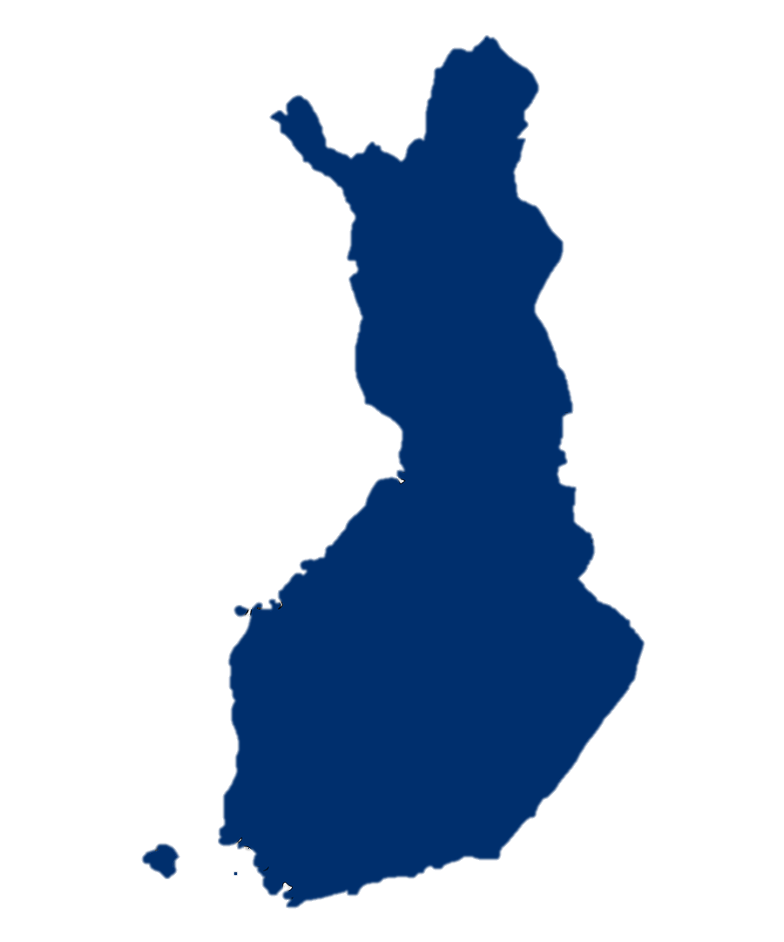
Finland ranked happiest country in the world, three times in a row!
“Are rich countries definitely happier than less well-off countries?”

Slide 6
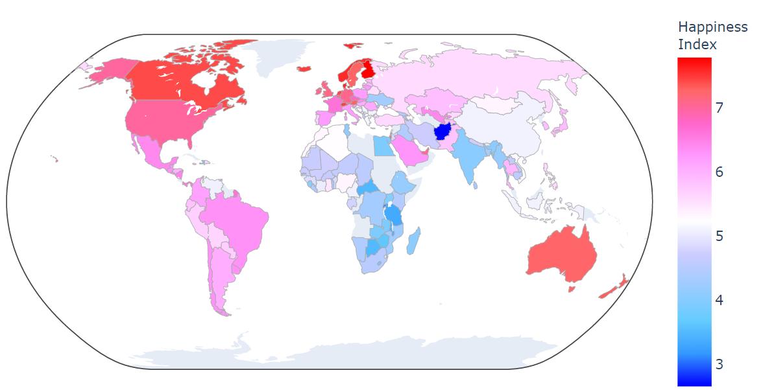
Happiness Index Across the Globe

Slide 7
Does money buy you happiness?
What other factors impact happiness?
How do relatively happy countries rank on the Happiness Index variables?
How do relatively happy countries rank on other factors?
How does Canada perform and compare to US?
Can happiness change over time?
Hypothesis A nation’s economic health does not impact its people’s happiness

Slide 8


Measuring economic health
Economic health variables
Gross domestic product (GDP)
Unemployment
Notes:
GDP: Gross Domestic Product (GDP) is the monetary value of all finished goods and services made within a country during a specific period. GDP provides an economic snapshot of a country, used to estimate the size of an economy and growth rate. GDP can be calculated in three ways, using expenditures, production, or incomes.
Used in analysis: Log GDP
Unemployment:
Used in analysis: % unemployment

Slide 9
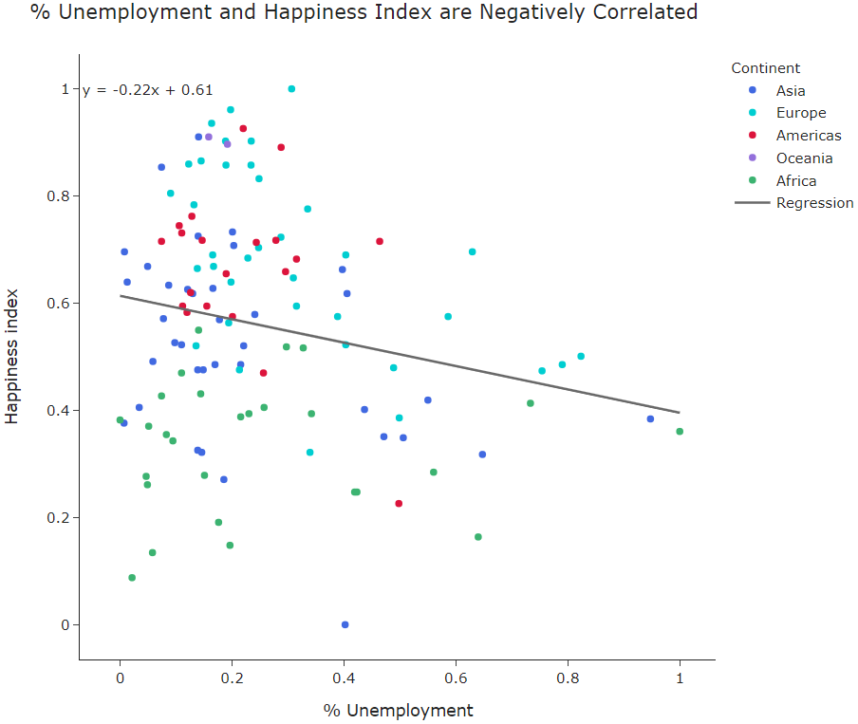
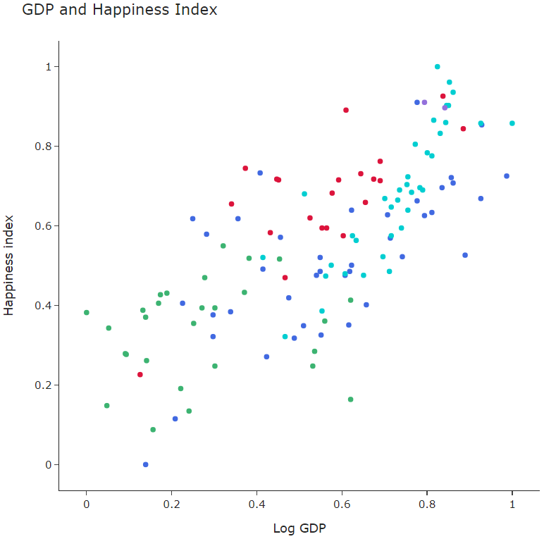
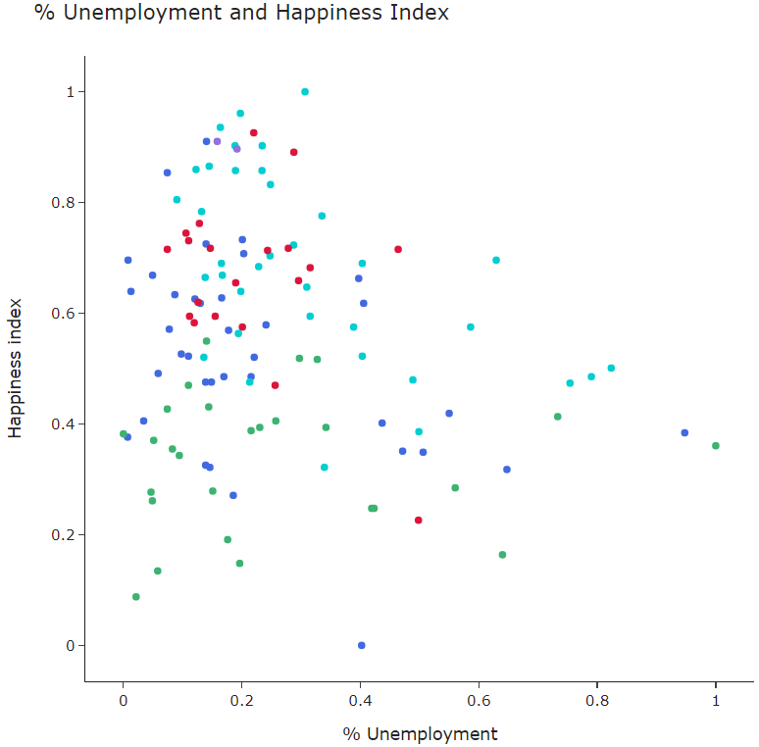
Do GDP and Unemployment correlate with the happiness Index?

Slide 10
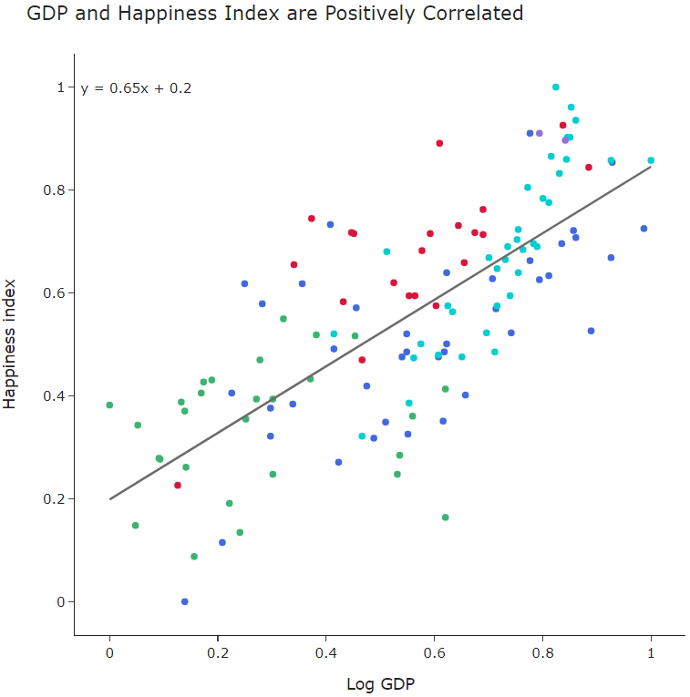
Regression analysis finds both GDP and unemployment are correlated with the Happiness Index, however there are exceptions
Costa Rica
Nicaragua
Brazil
Spain
r value: 0.74
r value: -0.21

Slide 11
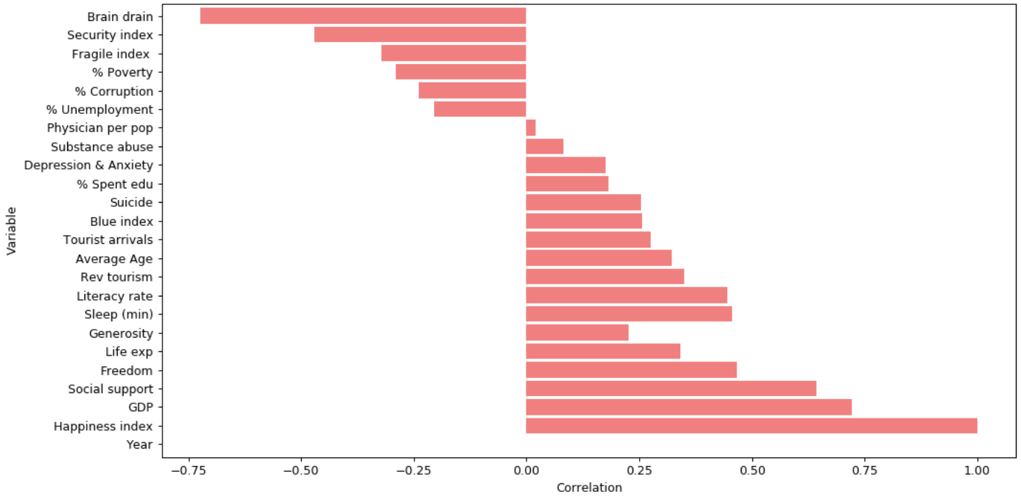
A series of variables (17 additional) from different datasets were compiled and analyzed for correlation with the Happiness Index
Negatively Correlated
Factors
Positively Correlated
Factors
Variables from the Happiness Index

Slide 12
A series of variables (17 additional) from different datasets were compiled and analyzed for correlation with the Happiness Index
Negatively Correlated
Factors
Positively Correlated
Factors
Variables from the Happiness Index

Slide 13
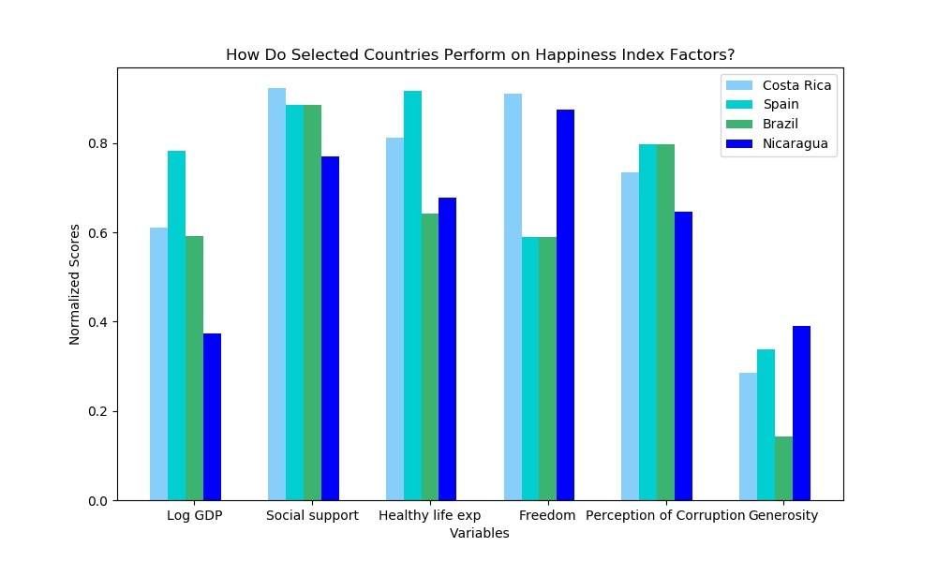
How do our relatively happy countries rank on the Happiness Index variables?
Normalized Scores for Happiness Index Variables (2017)
Scores vary along the Happiness Index factors among selected happy countries
All countries show high scores for Social Support
Costa Rica and Nicaragua score especially high on Freedom
Spain scores high on Healthy Life Expectancy
Interestingly, these selected countries rank low on Generosity

Slide 14
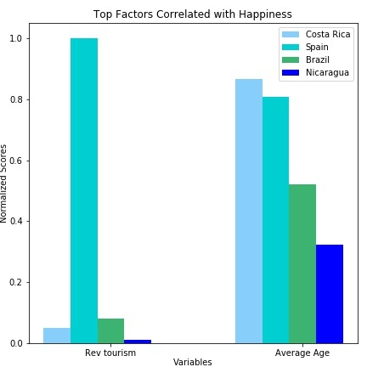
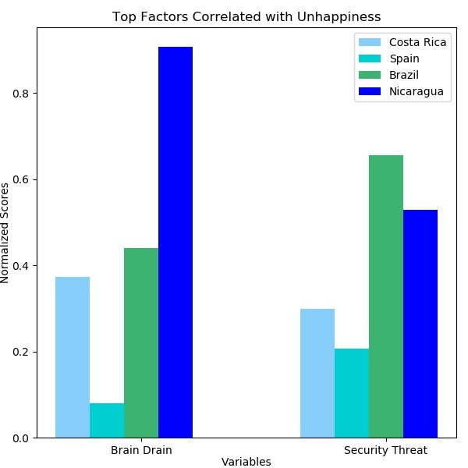
How do our relatively happy countries rank on additional happiness variables, correlated with the Happiness Index?
Scores for additional variables correlated with happiness vary among the selected happy countries
Spain scores high in both positively correlated variables Tourism revenue and Average age
Costa Rica and Spain both score low on negatively correlated variables Brain drain and Security threat
Interestingly, Nicaragua does not perform well across all four variables

Slide 15
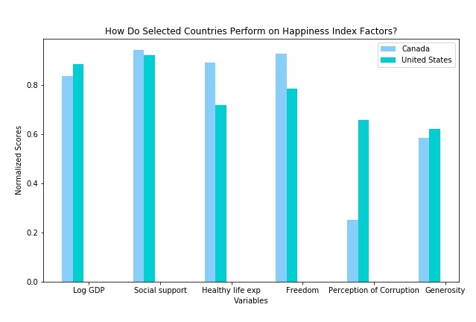
How do we (Canada) rank along the Happiness Index factors and the additional highly correlated variables?
Canada
US
With the exception of GDP & Generosity, Canada out performs the US across Happiness Index variables
Perception of corruption is especially low in Canada, compared to the US

Slide 16
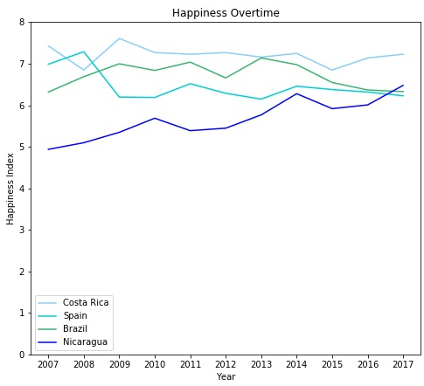
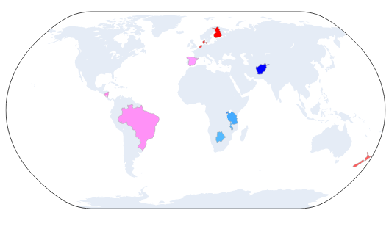
Can happiness change over time?
Happiness Over Time in Selected Happy Countries (2007 – 2017)
Globally, happiness as defined by the Happiness Index is relatively stable
From our selected happy countries, Nicaragua has been trending happier in more recent years, while Spain’s happiness has been slowly declining

Slide 17
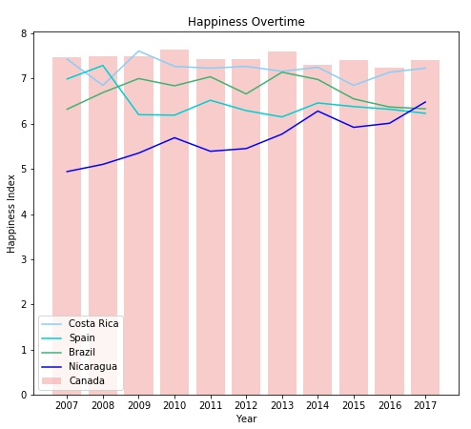
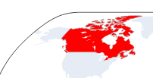
Can happiness change over time?
Happiness Over Time in Selected Happy Countries (2007 – 2017)
From our selected happy countries, Nicaragua has been trending happier in more recent years, while Spain’s happiness has been slowly declining
Canada’s Happiness Index has been relatively stable

Slide 18
Pursuit of Happiness
Does money buy happiness?
Money doesn’t necessarily buy happiness, but it helps
(Economic health is positively correlated with a nation’s Happiness Index)

Slide 19
Data sets
Primary dataset
Annual World Happiness Report
- UN Sustainable Development Solutions Network
Secondary datasets
Other variables
- Global Health Data Exchange (GHDx)
- The Global Economy
- Central Intelligence Agency (CIA)
- World Economic Forum
- The World Bank

Slide 20
Measuring happiness Data cleanup + analysis overview

Slide 21



Q&A

Slide 22
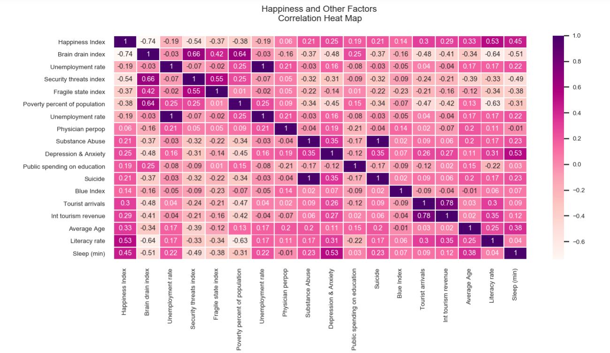

Slide 23
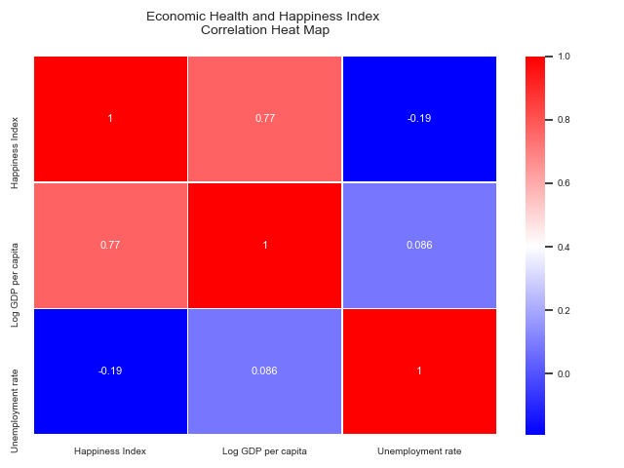

Slide 24
